Slide 1


Fake News Detection by Variational Autoencoder and Topic Modelling
Team 2:
Majid Feiz
Marjan Hosseini
4/28/2021

Slide 2



Introduction
Growth of social media.
Unauthenticated user generated content.
In the US, 62% of adults use social media as their source of daily news [2016, News use across social media platforms].
Around 70% of people can successfully validate the authenticity of the news [2017, Automatic detection of fake news].
1/13

Slide 3
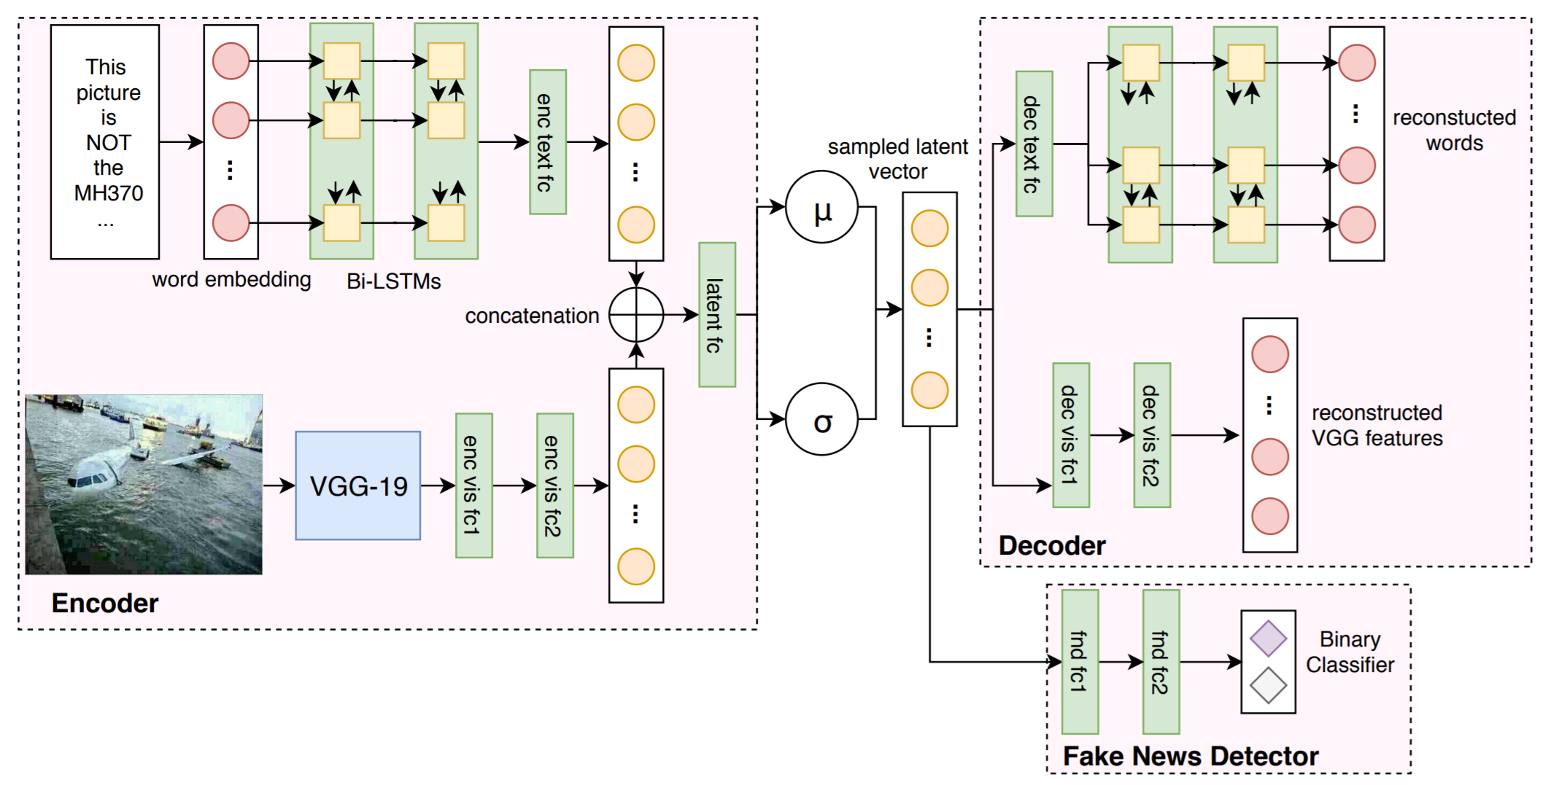
Related works
Existing Solution
Proposal
Contribution
MVAE: Multimodal variational autoencoder for fake news detection
Increasing the interpretability of the model by LDA.
Improving the accuracy by concatenating two types of features.
We use only textual content.
A multi-modal approach.
VAE captures textual content features.
LDA captures topic related features.
Together they increase the accuracy of the model.
[Khattar et al. 2019]
Challenges
Drawbacks
The absence of an agreed benchmark dataset.
Unclear definition of the fake news versus real.
Some news do not have visual content.
Not interpretable features.
2/13

Slide 4
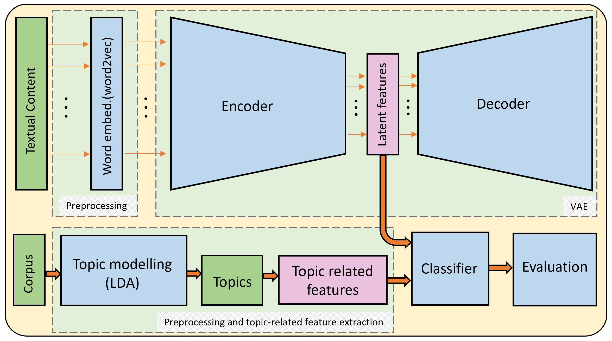
Information Flow
Main Components
1) Preprocessing
2) Variational Autoencoder
3) Topic Modelling (LDA)
4) Classifier
5) Evaluation
3/13

Slide 5
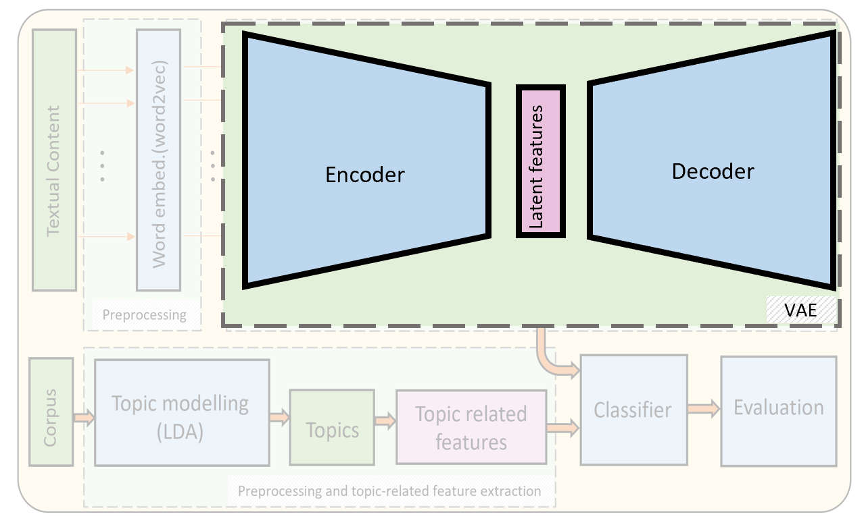
Technical Component 1: VAE
Post
L
W
Decoder
Word1
Word2
.
.
.
.
.
.
.
.
.
WordL
Dense (None, W)
Encoder
RepeatVector (None, L, W)
Word embed (word2vec)
Embedding (None, L, W)
LSTM (None, L, W)
Bi-LSTM (None, L, 2 x W)
LSTM (None, L, W)
Bi-LSTM (None, 2 x W)
TimeDistributed (None, L, N)
Dense (None, W)
Classifier
Losses
VAE:
Categorical cross-entropy
Classifier: MSE
Dense (None, W)
L: max length of the posts
W: word2vec dimension
N: # samples (posts)
Dense
Dense
VAE Latent features
4/13

Slide 6
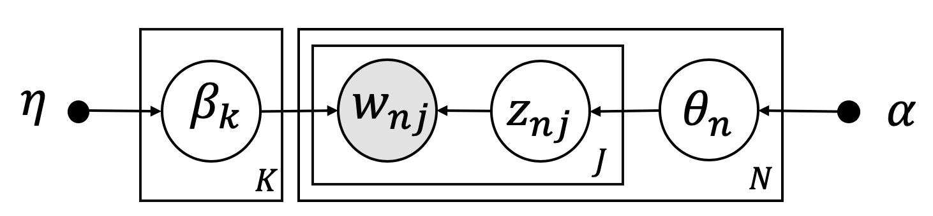
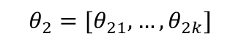
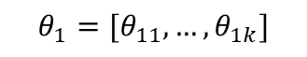
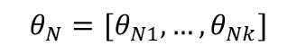
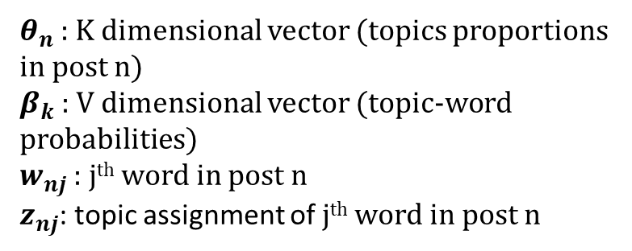
Technical Component 2: LDA
Corpus
Topic modelling
(LDA)
Topic related features
Topics
Preprocessing and topic-related feature extraction
Corpus
K
Post1
Post2
.
.
.
.
.
.
.
.
.
PostN
LDA model:
$$θ_{1}=[θ_{11}, …,θ_{1k}]$$
Post1
Post2
.
.
.
.
.
.
.
.
.
Post2
$$θ_{2}=[θ_{21}, …,θ_{2k}]$$
$θ_{n}$ : K dimensional vector (topics proportions in post n)
$β_{k}$ : V dimensional vector (topic-word probabilities)
$w_{nj}$ : j^{th} word in post n
$z_{nj}$: topic assignment of j^{th} word in post n
$$θ_{N}=[θ_{N1}, …,θ_{Nk}]$$
K: # topics
V: # words in the corpus
N: # samples (posts)
J: # of words in each post
Objective function:
Maximize likelihood
5/13

Slide 7
Technical Component 3: Classification
Corpus
LDA features
VAE features
Post1
Post2
.
.
.
.
.
.
.
.
.
PostN
LDA model:
Post1
Post2
.
.
.
.
.
.
.
.
.
Post2
Post1
Post2
.
.
.
.
.
.
.
.
.
Post2
$θ_{n}$ : K dimensional vector (topics proportions in post n)
$β_{k}$ : V dimensional vector (topic-word probabilities)
$w_{nj}$ : j^{th} word in post n
$z_{nj}$: topic assignment of j^{th} word in post n
K: # topics
V: # words in the corpus
N: # samples (posts)
J: # of words in each post
Binary Classifier
Objective:
Maximize likelihood
Evaluate
6/13

Slide 8



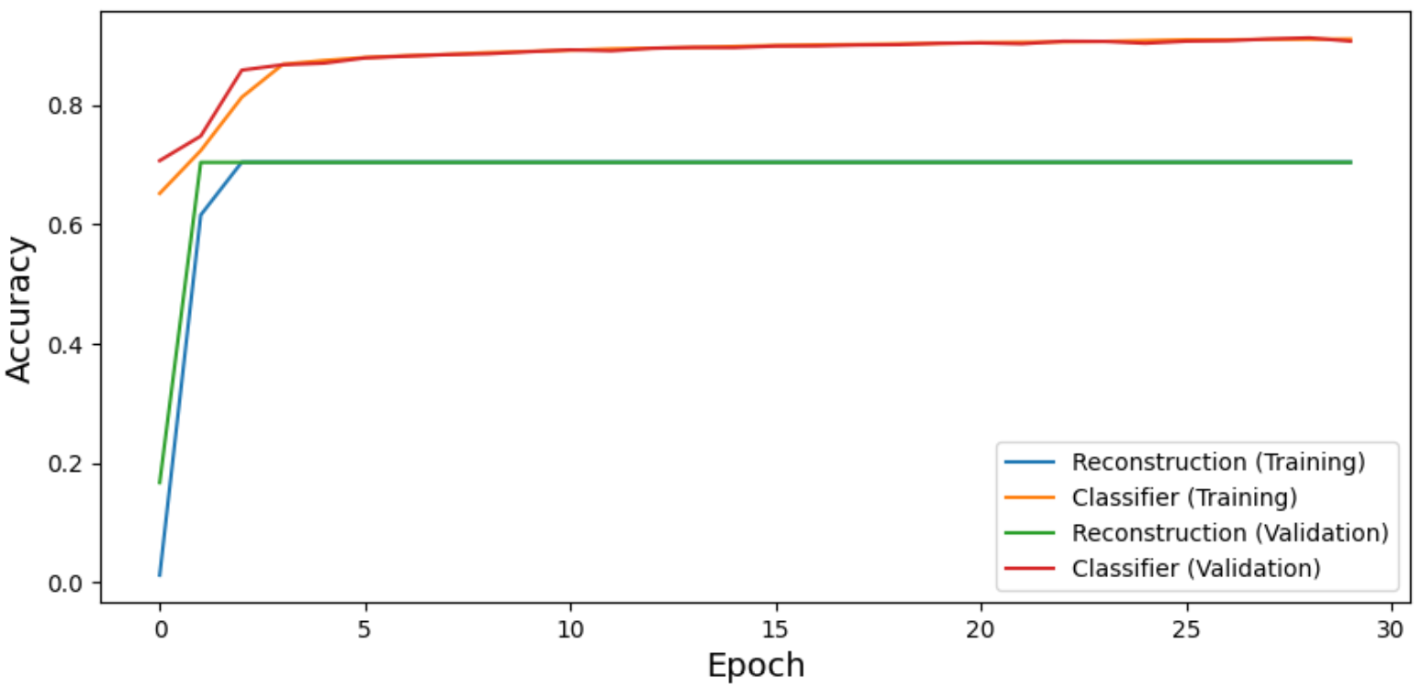
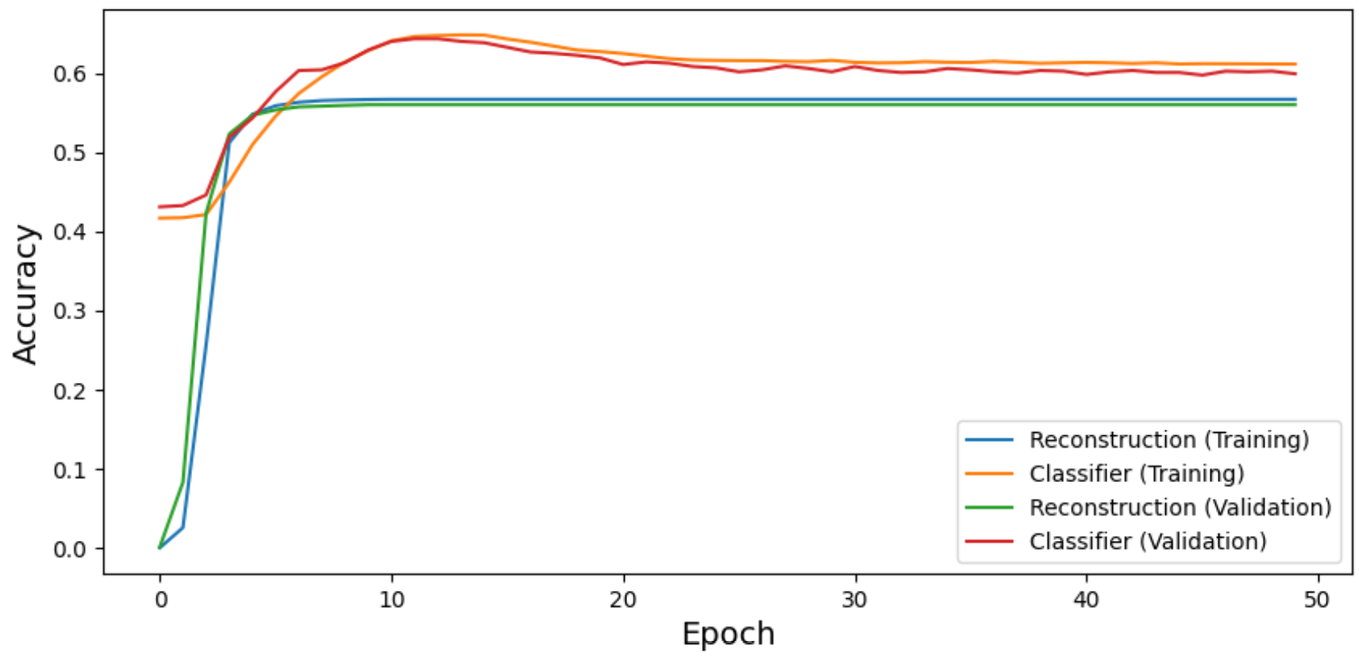
Experimental Settings
Datasets Characteristics:
Convergence:
Dataset | ISOT | Twitter
# training samples | 34684 | 12211
# test samples | 8672 | 1448
Max length of posts | 45 | 28
Original data | Fake/Real | Training/Test
Other | Stratified | No label on test
ISOT, 64 latent features
Settings:
LDA configuration:
Classifiers:
Max # words: 10000
# iteration: 1000
# topics: 2, 4, 8, 10, 16, 32, 64
Naïve Bayes, SVM, MLP, Logistic Regression, KNN, Random Forest
Twitter, 32 latent features
VAE configuration:
Dimensionality Reduction:
Epoch: 30 - 50
Latent dim = [2, 4, 8, 10, 16, 32, 64]
word2vec = [2, 4, 8, 10, 16, 32, 64]
PCA, tSNE
Feature Selection:
Kbest (chi², Gini index)
Environment:
Baseline:
UCONN UCHC Server, Python 3
Results on two feature sets alone
7/13

Slide 9
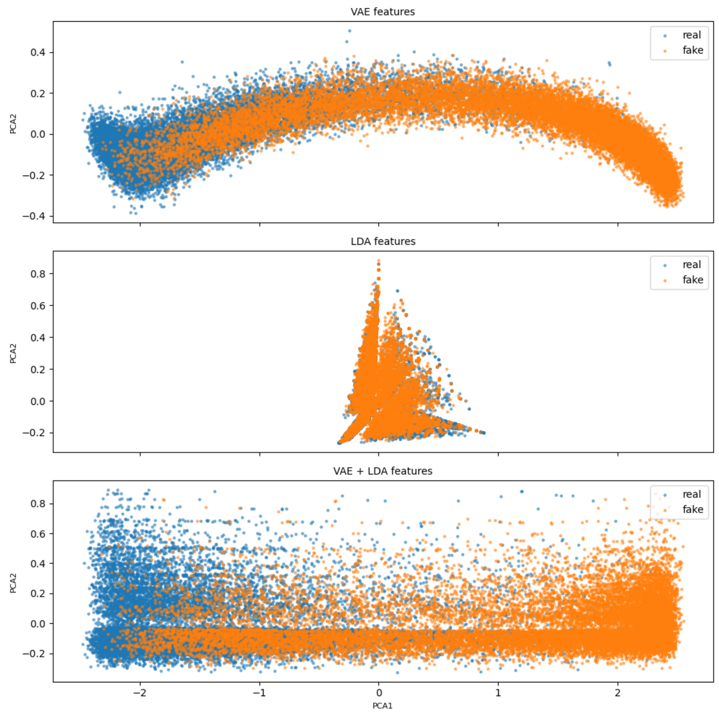
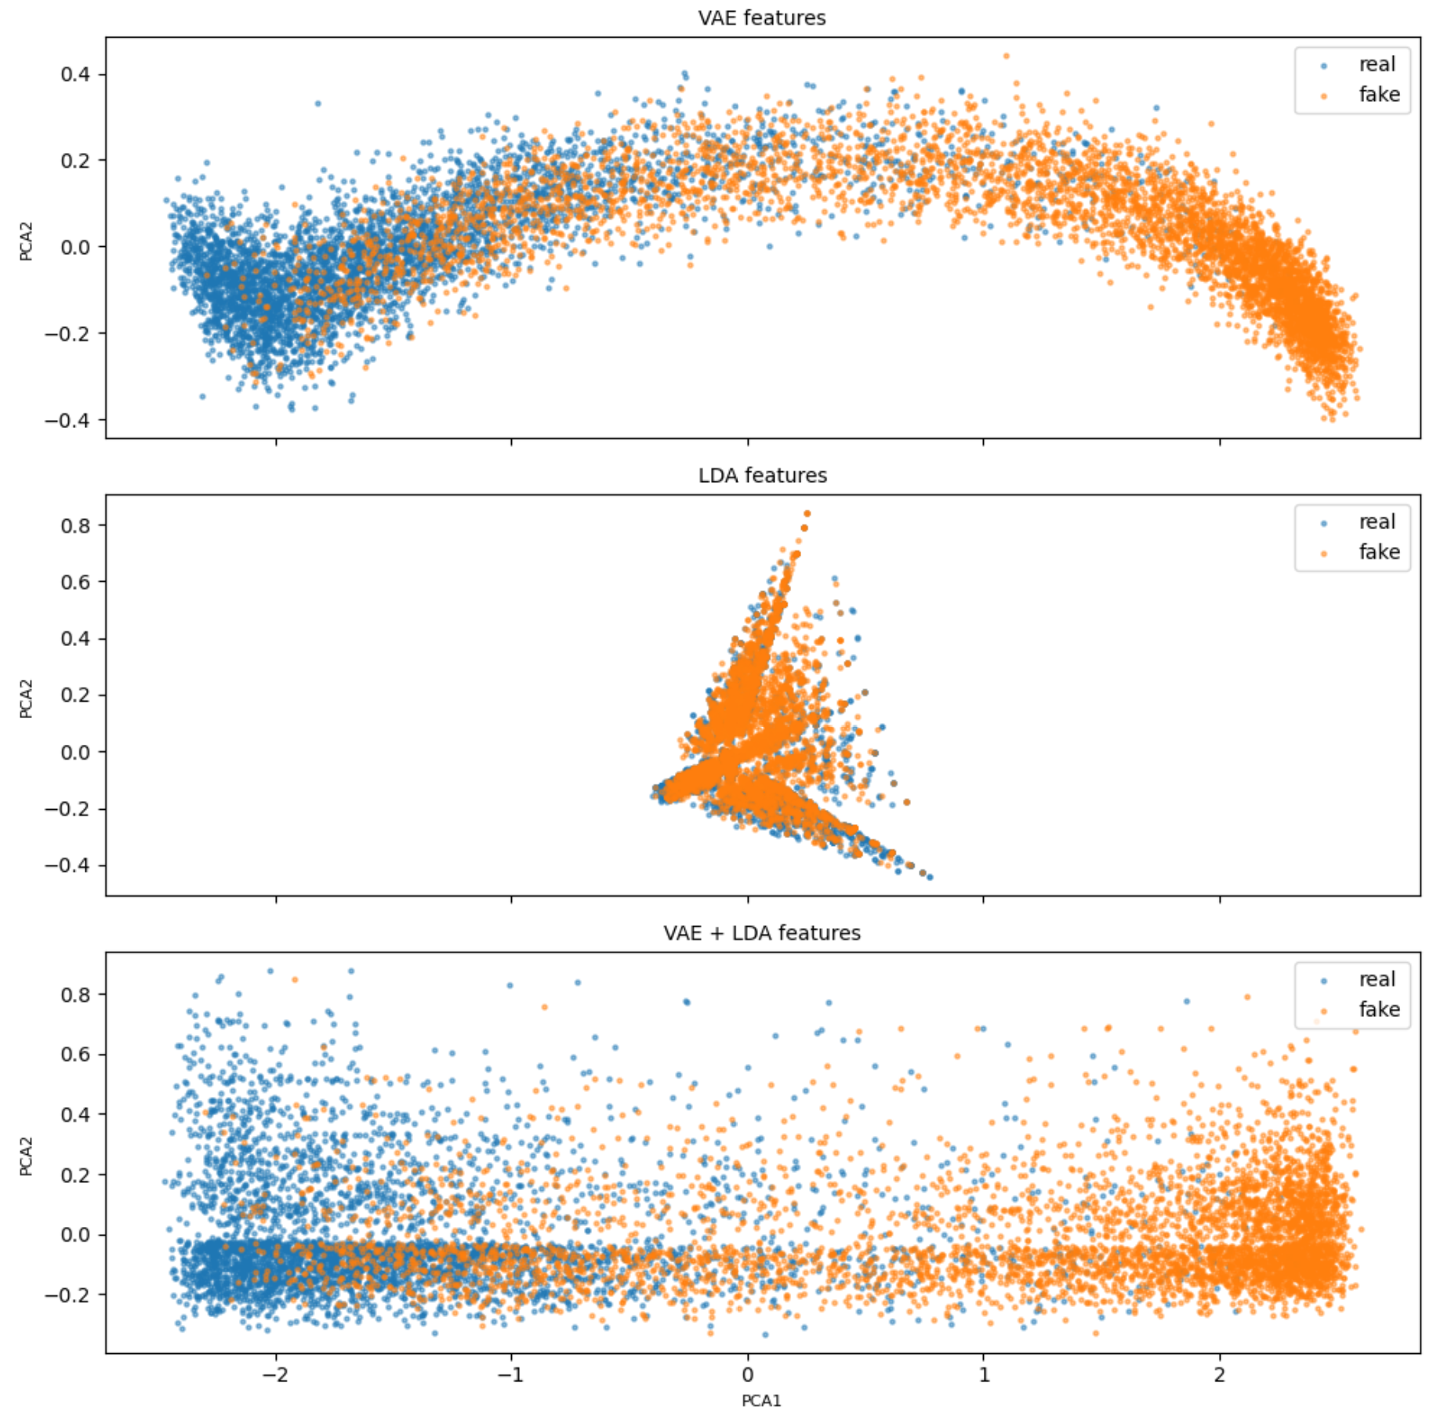
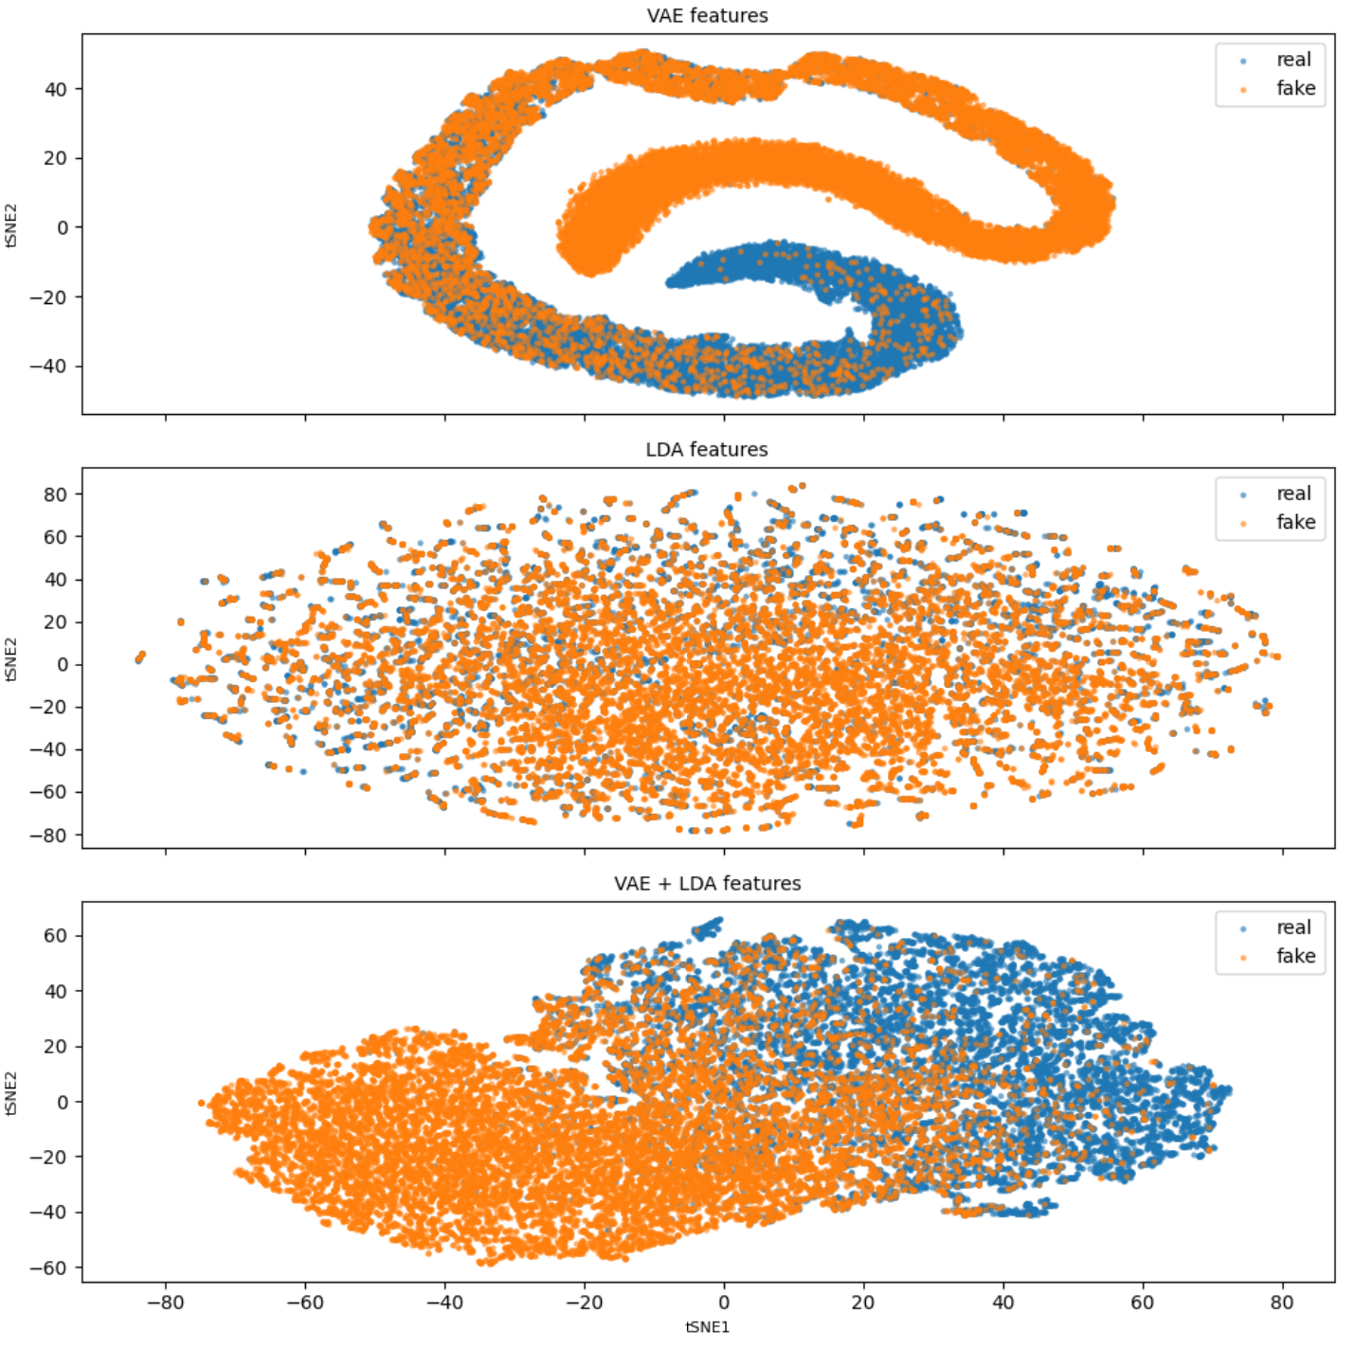
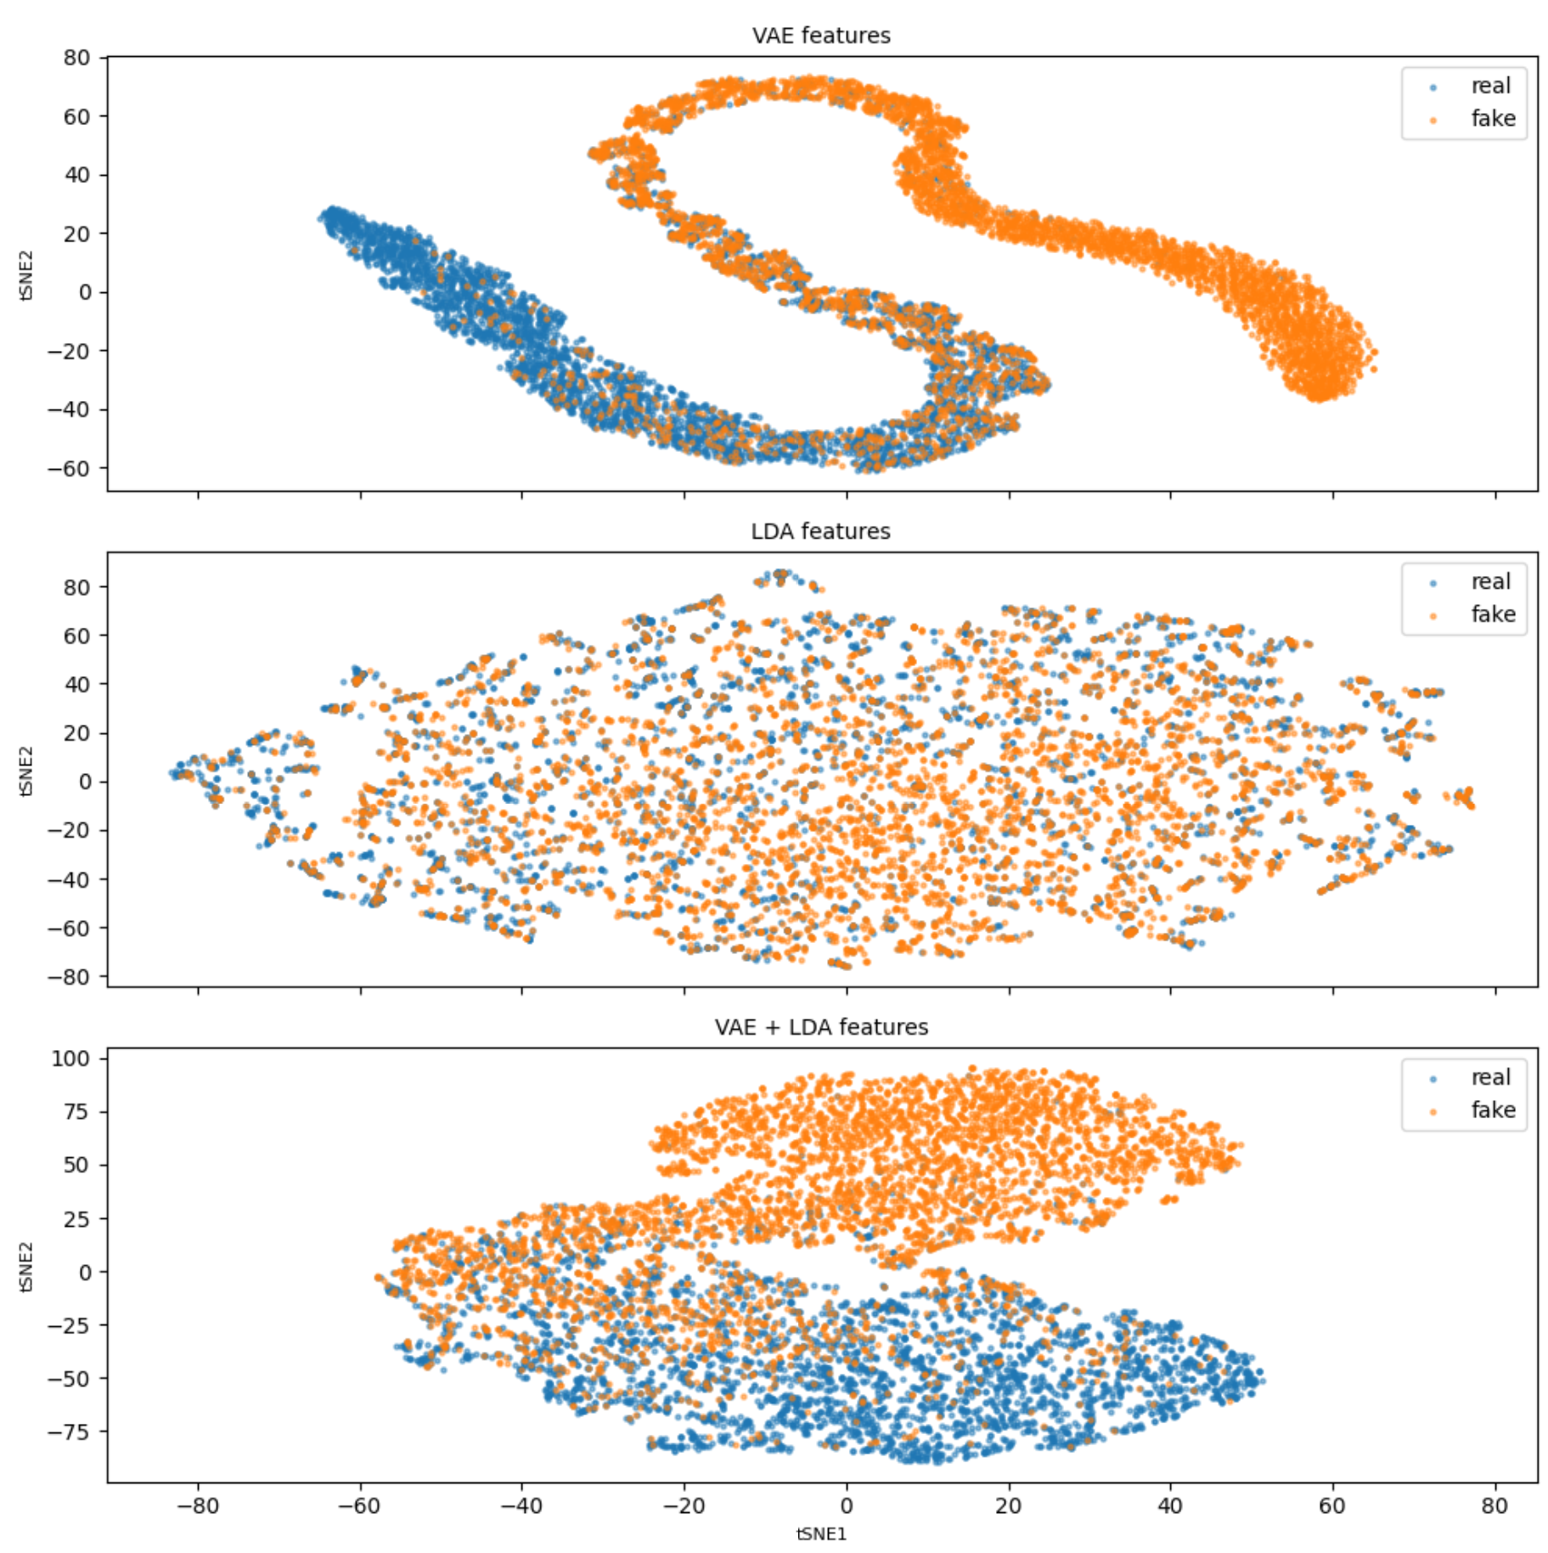
Results
Dimensionality reduction on obtained features on ISOT:
PCA, VAE 32 features, LDA 10 features
tSNE , VAE 32 features, LDA 10 features
VAE
VAE
VAE
VAE
LDA
LDA
LDA
LDA
VAE + LDA
VAE + LDA
VAE + LDA
VAE + LDA
Training set
Test set
Training set
Test set
8/13

Slide 10
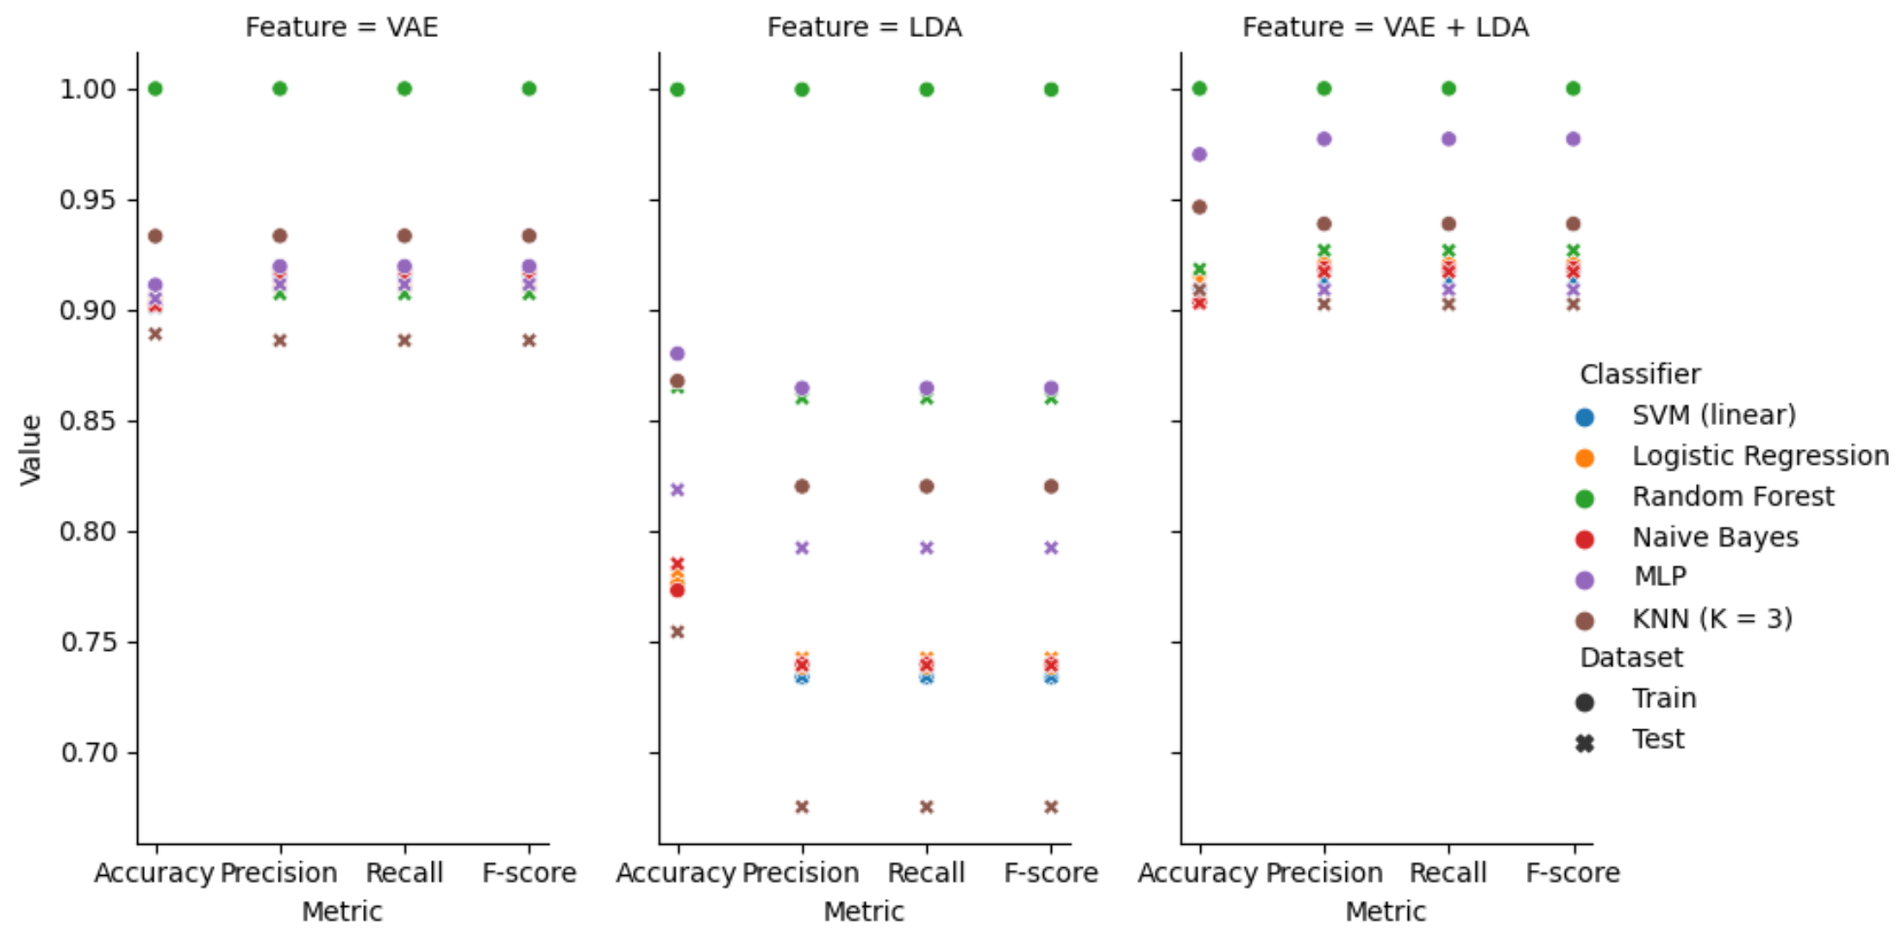
Results
Results on ISOT dataset (VAE 32 features, LDA 32 features):
9/13

Slide 11
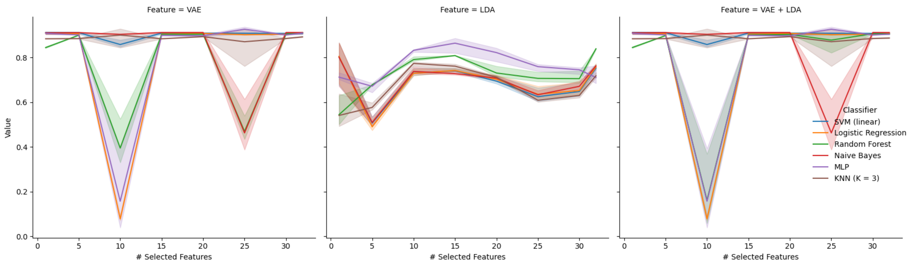
Results
Results on ISOT dataset (VAE 32 features, LDA 32 features):
Feature selection:
Univariate feature selection
Chi²
Dataset: Test data
Metric: Accuracy
10/13

Slide 12
Discussion
Advantages:
Disadvantages:
Our model improves the interpretability of the model.
Multimodal approach that incorporates two types of features which increases the accuracy.
Requires only textual content.
Computationally expensive, especially with large data.
LDA and VAE results are different in different runs, so multiple training might be required.
Dependent on the text preprocessing.
11/13

Slide 13
Conclusion and Future Work
Future Work:
Conclusion :
Tunning other hyper-parameters in the VAE including the layers configuration.
Apply multivariate feature selection algorithms.
Include other types of features, such as publishers.
Try other types of preprocessing.
Our model improves the accuracy of previous model.
We increase the interpretability by adding LDA component.
Multimodal approach that incorporates two types of features.
Requires only textual content.
12/13

Slide 14
References
Jeffrey Gottfried and Elisa Shearer. News use across social media platforms 2016. 2016.
Ver ́onica P ́erez-Rosas, Bennett Kleinberg, Alexandra Lefevre, and Rada Mihalcea. Automatic detection of fake news.arXiv preprintarXiv:1708.07104, 2017
Dhruv Khattar, Jaipal Singh Goud, Manish Gupta, and Vasudeva Varma. Mvae: Multimodal variational autoencoder for fake news detection. In The World Wide Web Conference, pages 2915–2921, 2019
David M Blei, Andrew Y Ng, and Michael I Jordan. Latent Dirichlet allocation. the Journal of machine Learning research, 3:993–1022, 2003.
Ian Goodfellow, Yoshua Bengio, and Aaron Courville. Deep Learning. MIT Press, 2016. http://www.deeplearningbook.org.
13/13

Slide 15
Thank you! Questions?

